Slide 2
Overall

Slide 3
Overall
Collector: a recipe for how to build a summary of the elements in the stream
Offer three main functionalities:
- Reducing and summarizing stream elements to a single value
- Grouping elements
- Partitioning elements
Notes:
A short circuit operator is one that doesn't necessarily evaluate all of its operands

Slide 4

Reducing and summarizing
To combine all the items in the stream into a single result

Slide 5

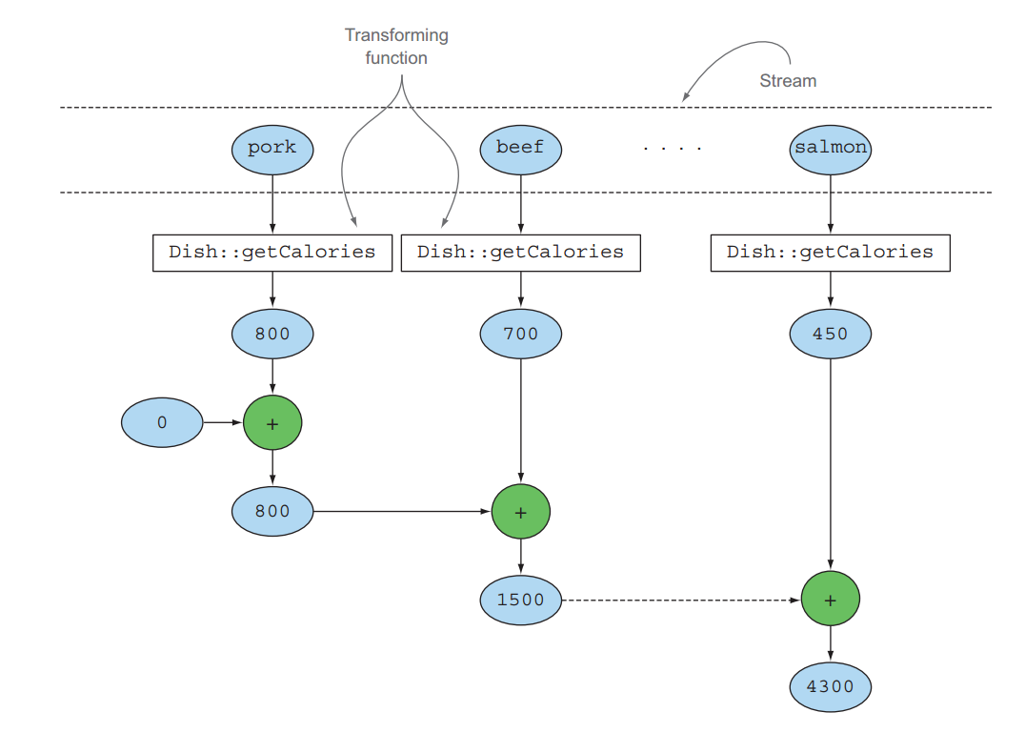

Example
Notes:
A short circuit operator is one that doesn't necessarily evaluate all of its operands

Slide 6
Joining Strings
Notes:
A short circuit operator is one that doesn't necessarily evaluate all of its operands

Slide 7
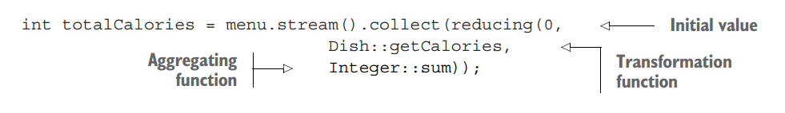
Reducing and collecting
Reduce method
Immutable reduction
Collect method
Mutable container to accumulate result
Useful for expressing but crucially in parallel-friendly
Notes:
A short circuit operator is one that doesn't necessarily evaluate all of its operands

Slide 8
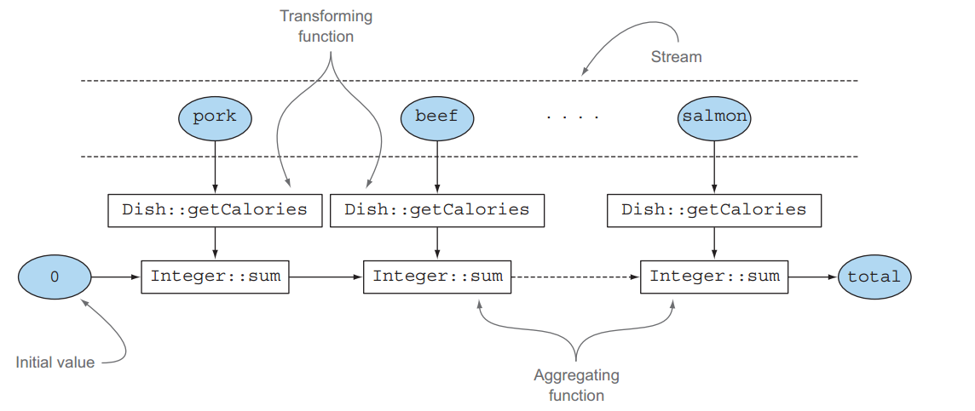
Reducing and collecting
Choosing the best solution for your situation
Notes:
A short circuit operator is one that doesn't necessarily evaluate all of its operands

Slide 9
Grouping
Notes:
A short circuit operator is one that doesn't necessarily evaluate all of its operands

Slide 10
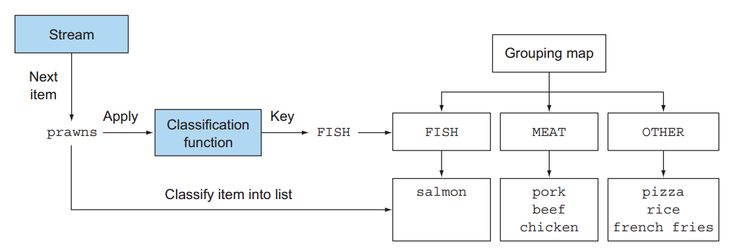
Grouping
Notes:
A short circuit operator is one that doesn't necessarily evaluate all of its operands

Slide 11

Partitioning
Notes:
advantage: partition can get 2 result (false & true), filter cannot

Slide 12
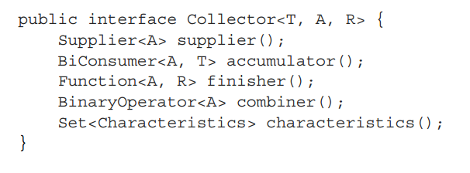
Collector Interface
T is the generic type of the items in the stream to be collected.
A is the type of the accumulator, the object on which the partial result will be accumulated during the collection process.
R is the type of the object (typically, but not always, the collection) resulting from the collect operation
Notes:
advantage: partition can get 2 result (false & true), filter cannot

Slide 13
The methods declared by Collector interface
supplier(): returns a Supplier of an empty accumulator
accumulator(): returns the function that performs the reduction operation
finisher(): returns a function that’s invoked at the end of the accumulation process to transform the accumulator object into the final result of the whole collection operation
combiner(): returns a function used by the reduction operation
characteristics(): returns an immutable set of Characteristics,
defining the behavior of the collector
Notes:
advantage: partition can get 2 result (false & true), filter cannot

Slide 14
Parallel data processing
and performance
Processing data in parallel with parallel streams
Performance analysis of parallel streams
The fork/join framework
Splitting a stream of data using a Spliterator

Slide 15
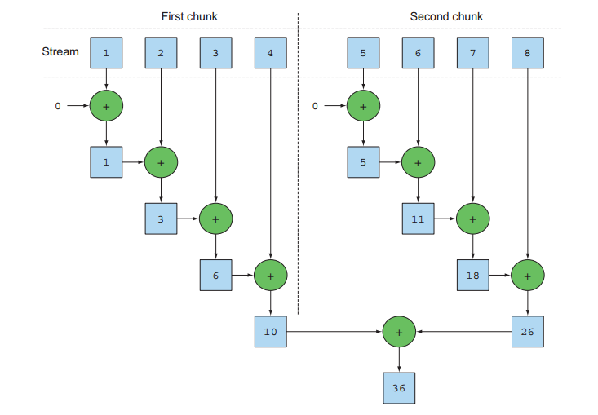

Slide 16
The last call to parallel or sequential wins and affects the pipeline globally.
Notes:
You can turn a parallel stream into a sequential one by invoking the method sequential on it.
By combining these two methods you could achieve finer-grained control over which operations you want to perform in parallel and which ones sequentially while traversing the stream.

Slide 17


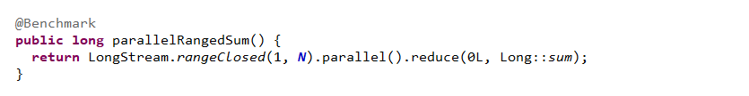
Notes:
Generates boxed objects, which have to be unboxed
Difficult to divide into independent chunks input of one function application always depends on the result of the previous application
rangeClosed:

Slide 18
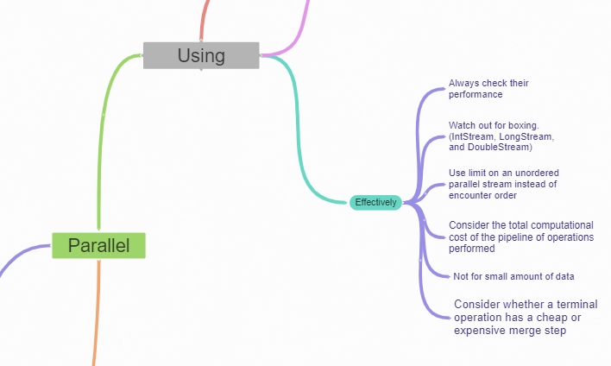
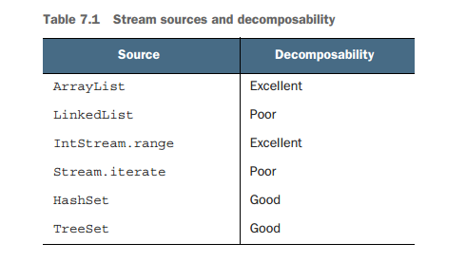

Slide 19
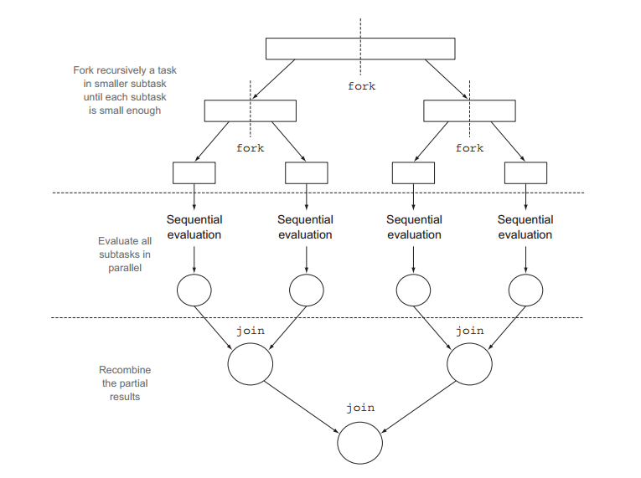
Fork/Join FrameWork
The fork/join framework was designed to recursively split a parallelizable task into smaller tasks and then combine the results of each subtask to produce the overall result.

Slide 20
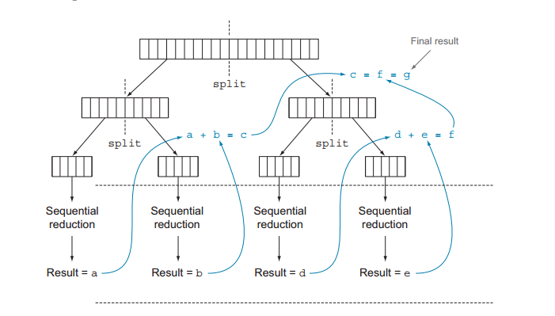

Slide 21
Best practices for using the fork/join framework
Invoking the join method on a task blocks the caller until the result produced by that task is ready.
Should always call the methods compute or fork directly; only sequential code should use invoke to begin parallel computation.
Calling the fork method on a subtask is the way to schedule it on the ForkJoinPool. Doing this allows you to reuse the same thread for one of the two subtasks and avoid the overhead caused by the unnecessary allocation of a further task on the pool.
Debugging a parallel computation using the fork/join framework can be tricky.
It’s always important to run the program multiple times before to measure its performance.
Notes:
because every subtask will have to wait for the other one to complete before starting.

Slide 22
Spliterator
Splitable + Iterator
traverse the elements of a source, but they’re also designed to do this in parallel.
tryAdvance: sequentially consume the elements of the Spliterator one by one, returning true if there are still other elements to be traverse.
trySplit: partition off some of its elements to a second Spliterator (the one returned by the method), allowing the two to be processed in parallel.
estimateSize: number of the elements remaining to be traverse
Notes:
Java 8 already provides a default Spliterator implementation for all the data structures included in its Collections Framework
The Collection interface now provides a default method spliterator() (you will learn more about default methods in chapter 13) which returns a Spliterator object.

Slide 23
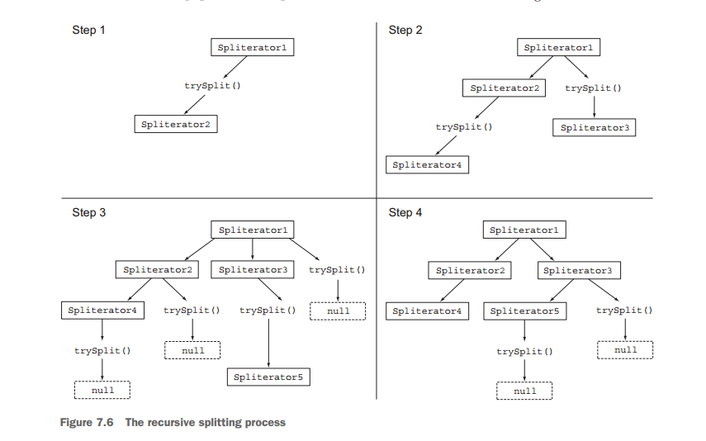

Slide 24
